Slide 1
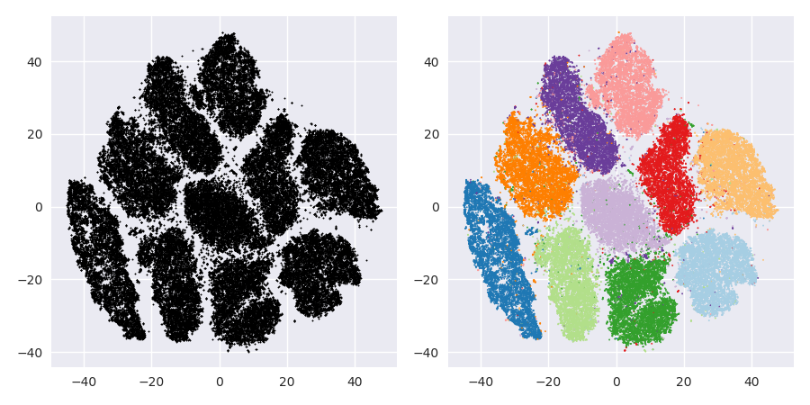
Clustering
Itay Hazan

Slide 2

Problem Definition

Slide 3
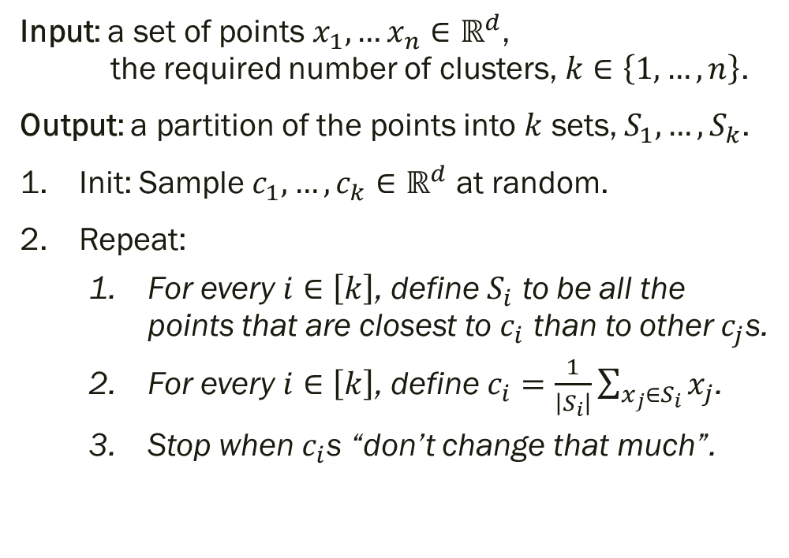
K-means Algorithm Idea
Input: a set of points $x_{1},…x_{n}∈ℝ^{d}$, the required number of clusters, $k∈\left\{1,…,n\right\}$.
Output: a partition of the points into $k$ sets, $S_{1},…,S_{k}$.
Init: Sample $c_{1},…,c_{k}∈ℝ^{d}$ at random.
Repeat:
For every $i∈\left[k\right]$, define $S_{i}$ to be all the points that are closest to $c_{i}$ than to other $c_{j}$s.
For every $i∈\left[k\right]$, define $c_{i}=\frac{1}{\left|S_{i}\right|}\sum_{x_{j}∈S_{i}}{x_{j}}$.
Stop when $c_{i}$s “don’t change that much”.

Slide 4
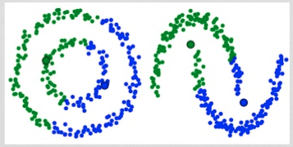
K-means Algorithm Fail Cases

Slide 5
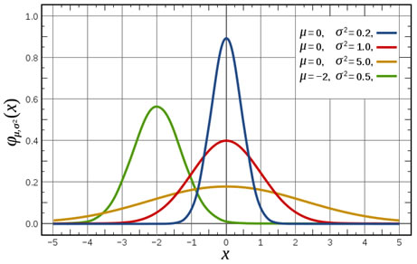

Reminder: Gaussian Distributions
A univariate Normal distribution is determined by its expectation $μ$ and variance $σ^{2}$.
$$X\sim N\left(μ,σ^{2}\right), f_{X}\left(x\right)=\frac{1}{\sqrt{2π}σ}e^{−\frac{{\left(x−μ\right)}^{2}}{2σ^{2}}}$$

Slide 6
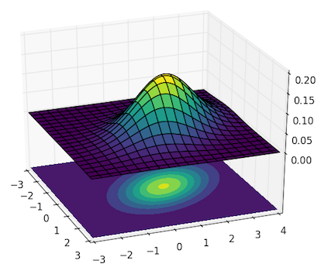
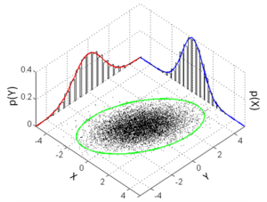
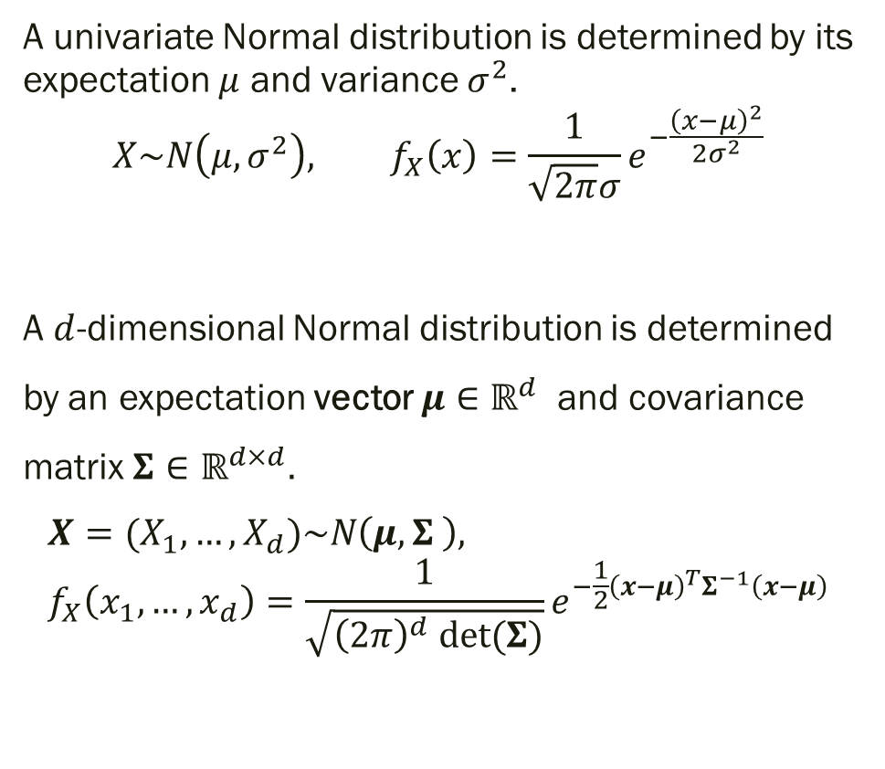
Reminder: Gaussian Distributions
A univariate Normal distribution is determined by its expectation $μ$ and variance $σ^{2}$.
$$X\sim N\left(μ,σ^{2}\right), f_{X}\left(x\right)=\frac{1}{\sqrt{2π}σ}e^{−\frac{{\left(x−μ\right)}^{2}}{2σ^{2}}}$$
A $d$-dimensional Normal distribution is determined by an expectation vector $μ∈ℝ^{d}$ and covariance matrix $Σ∈ℝ^{d×d}.$
$$X=(X_{1},…,X_{d})\sim N\left(μ,Σ \right), f_{X}\left(x_{1},…,x_{d}\right)=\frac{1}{\sqrt{{\left(2π\right)}^{d} det⁡(Σ)}}e^{−\frac{1}{2}{\left(x−μ\right)}^{T}Σ^{−1}\left(x−μ\right)}$$

Slide 7
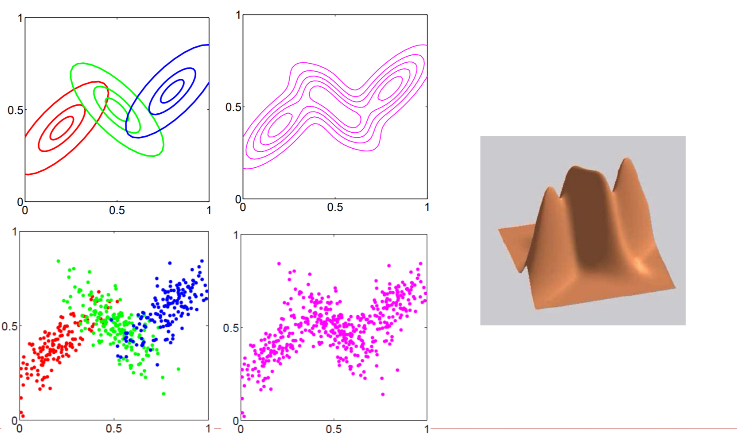
Expectation Minimization using Gaussian Mixture Models

Slide 8

Expectation Minimization using Gaussian Mixture Models
Input: a set of points $x_{1},…x_{n}∈ℝ^{d}$, the required number of clusters, $k∈\left\{1,…,n\right\}$.
Output: $k$ weighted $d$-dimensional Gaussians, ${\left\{\left(μ_{i},Σ_{i}\right)\right\}}_{i=1}^{k}$.

